Slide 1



Sales report
View in Power BI
Last data refresh:
17/12/2024 13:38:30 UTC
Downloaded at:
18/12/2024 17:35:42 UTC

Slide 2
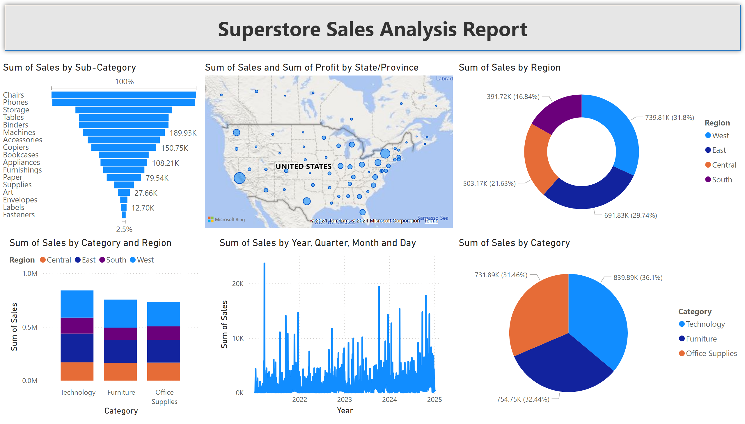
Page 1
Notes:
funnel
No alt text provided
lineStackedColumnComboChart
No alt text provided
map
No alt text provided
lineChart
No alt text provided
donutChart
No alt text provided
pieChart
No alt text provided
shape
No alt text provided

